Slide 1

Bagging and Random Forests
Chapter 08 (part 02)

Slide 2
Outline
Bagging
Bootstrapping
Bagging for Regression Trees
Bagging for Classification Trees
Out-of-Bag Error Estimation
Variable Importance: Relative Influence Plots
Random Forests

Slide 3
Problem!
Decision trees discussed earlier suffer from high variance!
If we randomly split the training data into 2 parts, and fit decision trees on both parts, the results could be quite different
We would like to have models with low variance
To solve this problem, we can use bagging (bootstrap aggregating).

Slide 4



Bootstrapping is simple!
Resampling of the observed dataset (and of equal size to the observed dataset), each of which is obtained by random sampling with replacement from the original dataset.
obs | x | y
3 | 5.3 | 2.8
1 | 4.3 | 2.4
3 | 5.3 | 2.8
$${\hat{α}}^{∗1}$$
Z^{*1}
obs | x | y
1 | 4.3 | 2.4
2 | 2.1 | 1.1
3 | 5.3 | 2.8
Z^{*2}
obs | x | y
2 | 2.1 | 1.1
2 | 2.1 | 1.1
1 | 4.3 | 2.4
$${\hat{α}}^{∗2}$$
the original dataset
Z
Z^{*3}
obs | x | y
2 | 2.1 | 1.1
3 | 5.3 | 2.8
1 | 4.3 | 2.4
$${\hat{α}}^{∗}$$

Slide 5
What is bagging?
Bagging is an extremely powerful idea based on two things:
Averaging: reduces variance!
Bootstrapping: plenty of training datasets!
Why does averaging reduces variance?
Recall that given a set of n independent observations Z₁, …, Z_{n}, each with variance σ², the variance of the mean of the observations is given by σ²/n

Slide 6
How does bagging work?
Generate B different bootstrapped training datasets
Train the statistical learning method on each of the B training datasets, and obtain the prediction
For prediction:
Regression: average all predictions from all B trees
Classification: majority vote among all B trees

Slide 7
Bagging for Regression Trees
Construct B regression trees using B bootstrapped training datasets
Average the resulting predictions
Note: These trees are not pruned, so each individual tree has high variance but low bias. Averaging these trees reduces variance, and thus we end up lowering both variance and bias ☺

Slide 8
Bagging for Classification Trees
Construct B regression trees using B bootstrapped training datasets
For prediction, there are two approaches:
Record the class that each bootstrapped data set predicts and provide an overall prediction to the most commonly occurring one (majority vote).
If our classifier produces probability estimates we can just average the probabilities and then predict to the class with the highest probability.
Both methods work well.

Slide 9
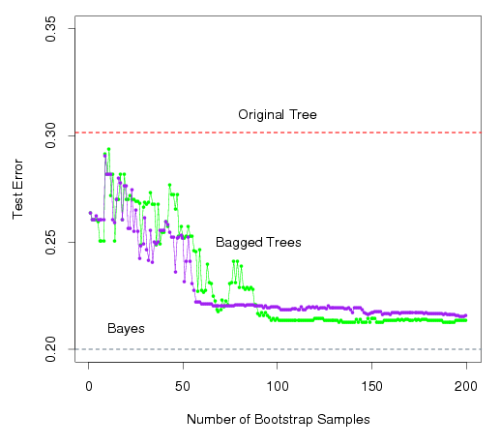
A Comparison of Error Rates
Here the green line represents a simple majority vote approach
The purple line corresponds to averaging the probability estimates.
Both do far better than a single tree (dashed red) and get close to the Bayes error rate (dashed grey).

Slide 10
Example 1: Housing Data
The red line represents the test mean sum of squares using a single tree.
The black line corresponds to the bagging error rate

Slide 11
Example 2: Car Seat Data
The red line represents the test error rate using a single tree.
The black line corresponds to the bagging error rate using majority vote while the blue line averages the probabilities.

Slide 12
Out-of-Bag Error Estimation
Since bootstrapping involves random selection of subsets of observations to build a training data set, then the remaining non-selected part could be the testing data.
On average, each bagged tree makes use of around 2/3 of the observations, so we end up having 1/3 of the observations used for testing

Slide 13
Variable Importance Measure
Bagging typically improves the accuracy over prediction using a single tree, but it is now hard to interpret the model!
We have hundreds of trees, and it is no longer clear which variables are most important to the procedure
Thus bagging improves prediction accuracy at the expense of interpretability
But, we can still get an overall summary of the importance of each predictor using Relative Influence Plots

Slide 14
Relative Influence Plots
How do we decide which variables are most useful in predicting the response?
We can compute something called relative influence plots.
These plots give a score for each variable.
These scores represents the decrease in MSE when splitting on a particular variable
A number close to zero indicates the variable is not important and could be dropped.
The larger the score the more influence the variable has.

Slide 15
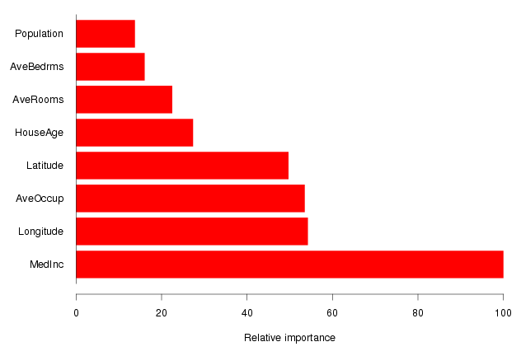
Example: Housing Data
Median Income is by far the most important variable.
Longitude, Latitude and Average occupancy are the next most important.

Slide 16
Random Forests
It is a very efficient statistical learning method
It builds on the idea of bagging, but it provides an improvement because it de-correlates the trees
How does it work?
Build a number of decision trees on bootstrapped training sample, but when building these trees, each time a split in a tree is considered, a random sample of m predictors is chosen as split candidates from the full set of p predictors (Usually )

Slide 17
Why are we considering a random sample of m predictors instead of all p predictors for splitting?
Suppose that we have a very strong predictor in the data set along with a number of other moderately strong predictor, then in the collection of bagged trees, most or all of them will use the very strong predictor for the first split!
All bagged trees will look similar. Hence all the predictions from the bagged trees will be highly correlated
Averaging many highly correlated quantities does not lead to a large variance reduction, and thus random forests “de-correlates” the bagged trees leading to more reduction in variance

Slide 18
Random Forest with different values of “m”
Notice when random forests are built using m = p, then this amounts simply to bagging.

